Slide 1
Chapter 1: The Need for Cybersecurity
Instructor Materials
Introduction to Cybersecurity v2.1
Notes:
Cisco Networking Academy Program
Introduction to Cybersecurity v2.1
Chapter 1: The Need for Cybersecurity

Slide 2
Instructor Materials – Chapter 1 Planning Guide
This PowerPoint deck is divided in two parts:
Instructor Planning Guide
Information to help you become familiar with the chapter
Teaching aids
Instructor Class Presentation
Optional slides that you can use in the classroom
Begins on slide # 9
Note: Remove the Planning Guide from this presentation before sharing with anyone.
Notes:
2

Slide 3
Chapter 1: The Need for Cybersecurity
Introduction to Cybersecurity v2.1
Planning Guide
Notes:
Cisco Networking Academy Program
Introduction to Cybersecurity v2.1
Chapter 1: The Need for Cybersecurity

Slide 4
Chapter 1: Activities
What activities are associated with this chapter?
Page # | Activity Type | Activity Name
1.2.1.3 | Lab | Compare Data with a Hash
1.2.2.5 | Lab | What Was Taken?
Notes:
4

Slide 5
Chapter 1: Assessment
Students should complete Chapter 1, “Assessment” after completing Chapter 1.
Quizzes, labs, and other activities can be used to informally assess student progress.
Notes:
5

Slide 6
Chapter 1: Best Practices
Prior to teaching Chapter 1, the instructor should:
Complete Chapter 1, “Assessment.”
Review the Additional Resources and Activities document in the Student Resources for possible additional resources and activities.
The objectives of this chapter are:
Define personal data.
Explain why personal data is profitable to hackers.
Describe types of data used by governments and organizations.
Describe the impact of a security breach.
Describe the characteristics and motives of an attacker.
Describe cyberwarfare.
Notes:
6

Slide 7
Chapter 1: Additional Help
For additional help with teaching strategies, including lesson plans, analogies for difficult concepts, and discussion topics, visit the Community Forums .
If you have lesson plans or resources that you would like to share, upload them to the Community Forums in order to help other instructors.
Notes:
7

Slide 9
Chapter 1: The Need for Cybersecurity
Introduction to Cybersecurity v2.1
Notes:
Cisco Networking Academy Program
Introduction to Cybersecurity v2.1
Chapter 1: The Need for Cybersecurity

Slide 10
Chapter 1 - Sections & Objectives
1.1 Personal Data
Explain the characteristics and value of personal data.
Define personal data.
Explain why personal data is profitable to hackers.
1.2 Organization Data
Explain the characteristics and value of data within an organization.
Describe types of data used by governments and organizations.
Describe the impact of a security breach.
1.3 Attackers and Cybersecurity Professionals
Explain the characteristics and motives of cyber attackers and the legal and ethical issues for cybersecurity professionals.
Describe the characteristics and motives of an attacker.
1.4 Cyberwarfare
Explain the characteristics and purpose of cyberwarfare.
Describe cyberwarfare.
Notes:
10
Cisco Networking Academy Program
Introduction to Cybersecurity v2.0
Chapter 1: The Need for Cybersecurity

Slide 11
1.1 Personal Data
Notes:
1 – The Need for Cybersecurity
1.1 – Personal Data

Slide 12

Personal Data Introduction to Personal Data
What is Cybersecurity?
Protection of networked system and data from unauthorized use or harm
Your Online and Offline Identity
Offline Identity
Your identity that interacts on a regular basis at home, school or work
Online Identity
Your identity while you are in cyberspace
Should only reveal a limited amount of information about you
Username or alias
Should not include any personal information
Should be appropriate and respectful
Should not attract unwanted attention
Notes:
1.1 – Personal Data
1.1.1 – Introduction to Personal Data
1.1.1.1 – What is Cybersecurity?
1.1.1.2 – Your Online and Offline Identity

Slide 13
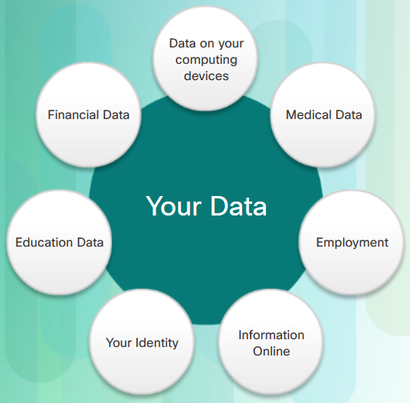
Personal Data Introduction to Personal Data
Your Data
Medical Records
electronic health records (EHR) – physical, mental, and other personal information
prescriptions
Education Records
Grades, test scores, courses taken, awards and degrees rewarded
Attendance
Disciplinary reports
Employment and Financial Records
Income and expenditures
Tax records – paycheck stubs, credit card statements, credit rating and banking statement
Past employment and performance
Notes:
1.1 – Personal Data
1.1.1 – Introduction to Personal Data
1.1.1.3 – Your Data

Slide 14

Personal Data Introduction to Personal Data
Where is Your Data?
Medical records: doctor’s office, insurance company
Store loyalty cards
Stores compile your purchases
Marketing partner uses the profiles for target advertisement
Online pictures: friends, strangers may also have a copy
Your Computer Devices
Data storage and your portal to your online data
List some example of your computing devices
Notes:
1.1 – Personal Data
1.1.1 – Introduction to Personal Data
1.1.1.4 – Where is Your Data?
1.1.1.5 – Your Computing Devices

Slide 15


Personal Data Personal Data as a Target
How do the criminals get your money?
Online credentials
Gives thieves access to your accounts
Creative schemes
Trick into wiring money to your friends or family
Why do they want your identity?
Long-term profits
Medical benefits
File a fake tax return
Open credit card accounts
Obtain loans
Notes:
1.1 – Personal Data
1.1.2 – Personal Data as a Target
1.1.2.1 – They Want Your Money
1.1.2.2 – They Want Your Identity

Slide 16
1.2 Organizational Data
Notes:
1 – The Need for Cybersecurity
1.2 – Organizational Data

Slide 17
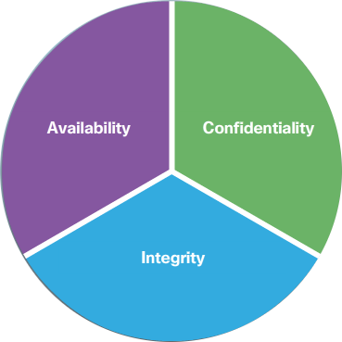
Organizational Data Introduction to Organizational Data
Types of Organizational Data
Traditional Data
Personnel – application materials, payroll, offer letter, employee agreements
Intellectual – patents, trademarks, product plans, trade secrets
Financial – income statements, balance sheets, cash flow statements
Internet of Things and Big Data
IoT – large network of physical objects, such as sensors
Big Data – data from the IoT
Confidentiality, Integrity and Availability
Confidentiality – privacy
Integrity – accuracy and trustworthiness of the information
Availability – information is accessible
Notes:
1.2 – Organizational Data
1.2.1 – Introduction to Organizational Data
1.2.1.1 – Types of Organizational Data
1.2.1.2 – Confidentiality, Integrity and Availability

Slide 18
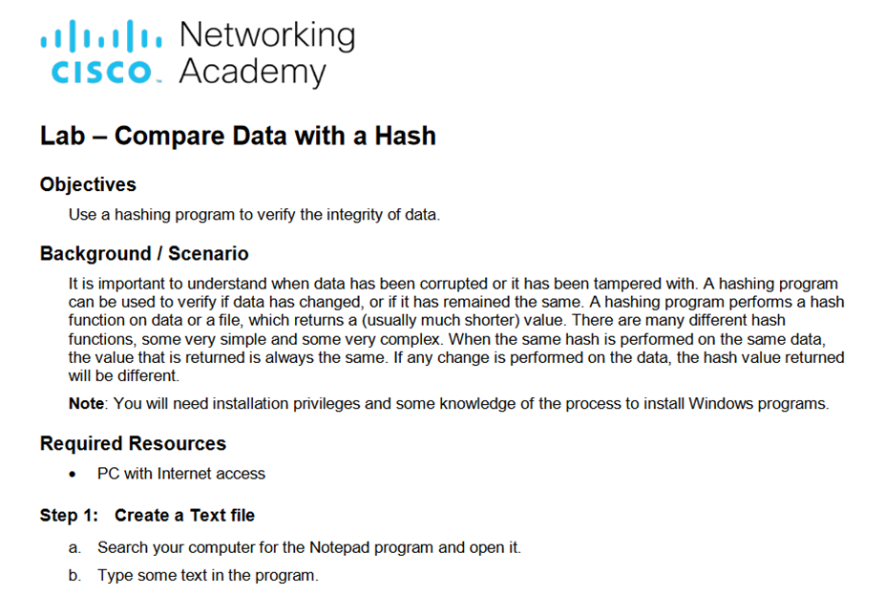
Introduction to Organizational Data Lab – Compare Data with a Hash
Notes:
1.2 – Organizational Data
1.2.1 – Introduction to Organizational Data
1.2.1.3 - Lab – Compare Data with a Hash

Slide 19
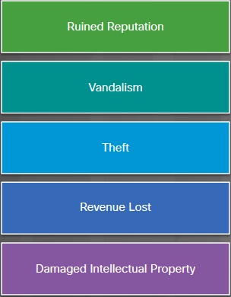
Organizational Data The Impact of a Security Breach
The Consequences of a Security Breach
Not feasible to prevent every attack
Attackers will always find new ways
Ruined reputation, vandalism, theft, revenue lost, damaged intellectual property
Security Breach Example - LastPass
An online password manager
Stolen email addresses, password reminders, and authentication hashes
Requires email verification or multi-factor authentication when logging in from an unknown device
Users should use complex master password, change master password periodically, and beware of phishing attacks
Notes:
1.2 – Organizational Data
1.2.2 – The Impact of a Security Breach
1.2.2.1 – The Consequences of a Security Breach
1.2.2.2 – Security Breach Example 1

Slide 20

Organizational Data The Impact of a Security Breach
Security Breach Example - Vtech
Vtech is a high tech toy maker for children
exposed sensitive information including customer names, email addresses, passwords, pictures, and chat logs.
Vtech did not safeguard information properly
Hackers can create email accounts, apply for credits, and commit crimes using the children’s information
Hackers can also take over the parents’ online accounts
Security Breach Example - Equifax
Equifax is a consumer credit reporting agency.
Attackers exploited a vulnerability in web application software.
Equifax established a dedicated web site with a new domain name that allowed nefarious parties to create unauthorized websites for phishing scheme
Notes:
1.2 – Organizational Data
1.2.2 – The Impact of a Security Breach
1.2.2.3 – Security Breach Example 2
1.2.2.4 – Security Breach Example 3

Slide 21
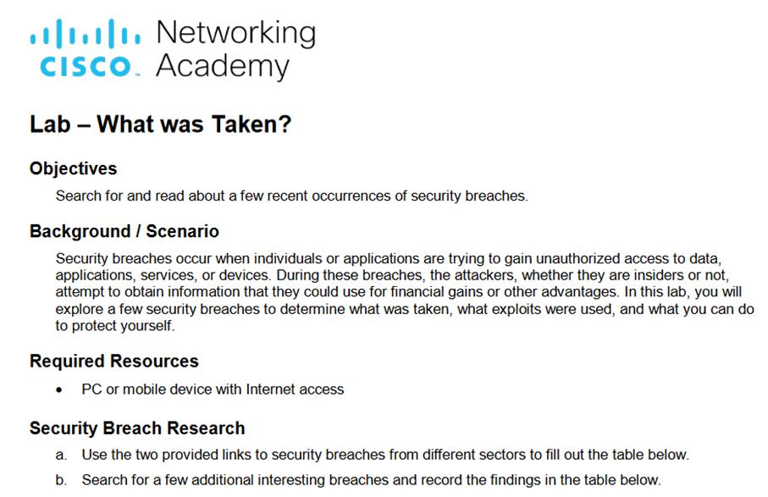
The Impact of a Security Breach Lab – What Was Taken?
Notes:
1.2 – Organizational Data
1.2.2 – The Impact of a Security Breach
1.2.2.5 – Lab – What Was Taken?

Slide 22
1.3 Attackers and Cybersecurity Professionals
Notes:
1 – The Need for Cybersecurity
1.3 – Attackers and Cybersecurity Professionals

Slide 23
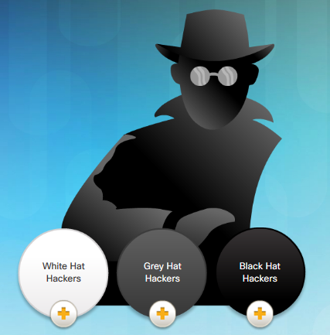
The Profile of a Cyber Attacker Types of Attackers
Amateurs
Script kiddies with little or no skill
Using existing tools or instructions found online for attacks
Hackers - break into computers or networks to gain access
White hats – break into system with permission to discover weaknesses so that the security of these systems can be improved
Gray hats – compromise systems without permission
Black hats - take advantage of any vulnerability for illegal personal, financial or political gain
Organized Hackers - organizations of cyber criminals, hacktivists, terrorists, and state-sponsored hackers.
Notes:
1.3 – Attackers and Cybersecurity Professionals
1.3.1 – The Profile of a Cyber Attacker
1.3.1.1 – Types of Attackers

Slide 24
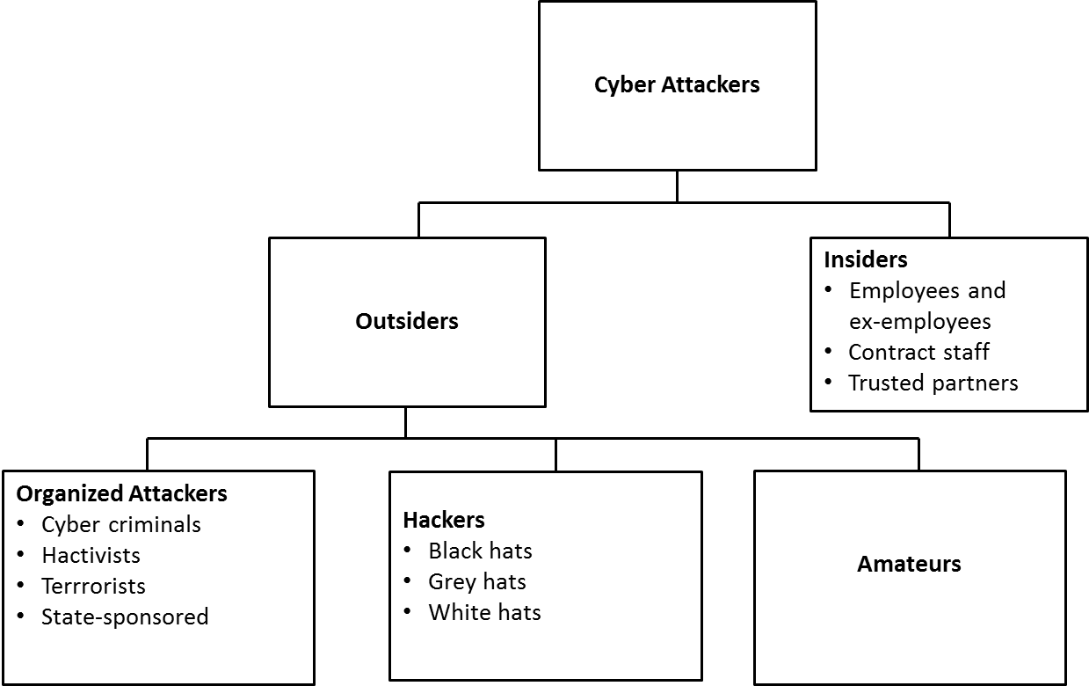
The Profile of a Cyber Attacker Internal and External Threats
Internal Security Threats
Can be an employee or contract partner
Mishandle confidential data
Threaten the operations of internal servers or network infrastructure devices
Facilitate outside attacks by connecting infected USB media into the corporate computer system
Accidentally invite malware onto the network through malicious email or websites
Can cause great damage because of direct access
External Security Threats
exploit vulnerabilities in network or computing devices
use social engineering to gain access
Notes:
1.3 – Attackers and Cybersecurity Professionals
1.3.1 – The Profile of a Cyber Attacker
1.3.1.2 - Internal and External Threats

Slide 25
1.4 Cyberwarfare
Notes:
1 – The Need for Cybersecurity
1.4 - Cyberwarfare

Slide 26
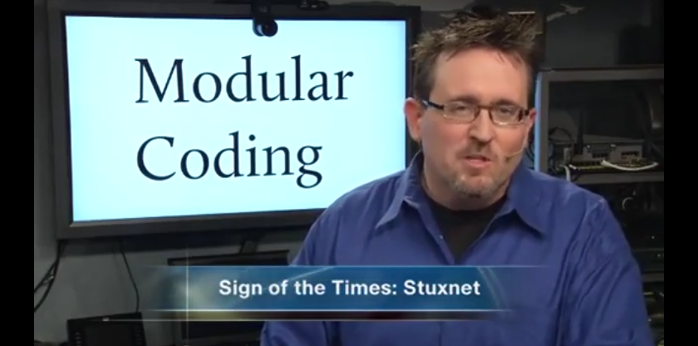
Overview of Cyberwarfare What is Cyberwarfare
What is Cyberwarfare?
Conflict using cyberspace
Stuxnet malware
Designed to damage Iran’s nuclear enrichment plant
Used modular coding
Used stolen digital certificates
Notes:
1.4 - Cyberwarfare
1.4.1 – Overview of Cyberwarfare
1.4.1.1 – What is Cyberwarfare?

Slide 27

Overview of Cyberwarfare The Purpose of Cyberwarfare
Use to gain advantage over adversaries, nations or competitors
Can sabotage the infrastructure of other nations
Give the attackers the ability to blackmail governmental personnel
Citizens may lose confidence in the government’s ability to protect them.
Affect the citizens’ faith in their government without ever physically invading the targeted nation.
Notes:
1.4 - Cyberwarfare
1.4.1 – Overview of Cyberwarfare
1.4.1.2 – The Purpose of Cyberwarfare

Slide 28
1.5 Chapter Summary
Notes:
1 – The Need for Cybersecurity
1.5 - Summary

Slide 29
Chapter Summary Summary
Define personal data.
Explain the characteristics and value of personal data.
Explain the characteristics and value of data within an organization.
Describe the impact of security breach.
Describe the characteristics and motives of an attacker.
Describe the legal and ethical issues facing a cybersecurity professional.
Explain the characteristics and purpose of cyberwarfare.
Notes:
1.5.1.1 - Summary

